Slide 1
APPLICATION DEMO & PROGRESS UPDATE
G7T3
Ethan Yang, Kwon Soo Yeon, Nanda Gian,
Qi Haodi, Yanrui Sia

Slide 2
TABLE OF CONTENTS
01
03
Functionalities
Bug Metrics
02
04
Schedule
Roles & Responsibility

Slide 3
FUNCTIONALITIES
Do you plan to drop/add any functionalities?
Do you plan to use any PHP frameworks?
No
No

Slide 4
(**NEW**)
FUNCTIONALITIES
3)What functionalities have you finished?
Login, Authentication, Protect, Bootstrap, Bid Section
update bid, drop bid, drop section; user-dump, section-dump, bid-dump, start a round and stop a round with round 1 clearing logic
What is the admin password for your cloud deployment?
DeductYourEdollar100!!!
IP address: 3.15.234.42

Slide 5
(**NEW**)
SCHEDULE
ITERATION 1
ITERATION 3
INTRODUCTION
TO SPM
(**NEW**)
ITERATION 5
Week 13
ITERATION 2
(**NEW**)
ITERATION 4
Week 5 & 6
Week 9 & 10
Week 7 & 8
Week 11 & 12

Slide 6
ITERATION 1 (16/09/19 - 29/09/19)
WEEK 5:
Back-end
SQL script for creating table and inserting data
Functionalities
Login
Authentication
Protect
WEEK 6:
Back-end
Validation
Functionalities
Bid section
Bootstrap (both UI & JSON)

Slide 7
(**NEW**)
ITERATION 2 (30/09/19 - 13/10/19)
WEEK 7:
Functionalities
Update bid
Drop bid
section-dump
bid-dump
user-dump
WEEK 8:
Functionalities
Drop section
Start and stop round 1

Slide 8
(**NEW**)
ITERATION 3 (14/10/19 - 27/10/19)
WEEK 9:
Functionalities
Start and stop round 2
dump all table web service
WEEK 10:
Improve functionalities

Slide 9
(**NEW**)
ITERATION 4 (28/10/19 - 17/11/19)
WEEK 11 - 12:
Final debugging
any use cases that
we did not cover
Update documents

Slide 10
(**NEW**)
ITERATION 5 (17/11/19 - 24/11/19)
WEEK 13:
Update and tidy up all documents and metrics
Overall code review
Final round of checking

Slide 11
MILESTONES
PM Review
Application Demo and Progress Update
UAT
Internal Code Review
Final Presentation

Slide 12
BUFFER TIME
Every Sunday for all iterations

Slide 13
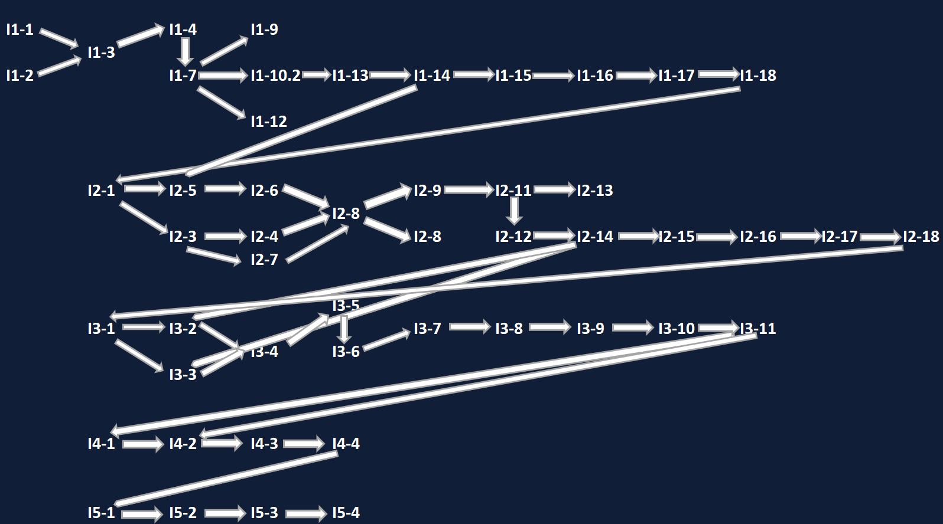
(**NEW**)
CRITICAL PATH

Slide 14
(**NEW**)
Bug Metrics
Iteration 1
14 identified bugs
111 points
Iteration 2
14 identified bugs
79 points
most bugs are found during testing sessions
bugs are fixed on the spot
No unresolved bugs

Slide 15
(**NEW**)
BUG METRICS
Iteration | Function | Description | Severity | Points | Mitigation
2 | section-dump | amount of the bid is shown as an integer when the value is a whole number | low | 1 | Stop current development and resolve the bug immediately. Project Manager reschedules the project.
2 | bid-dump | amount of the bid is shown as an integer when the value is a whole number | low | 1
2 | delete-bid | run into error as function parameters are not updated | Critical | 10

Slide 16
(**NEW**)
BUG METRICS
Iteration | Function | Description | Severity | Points | Mitigation
2 | bootstrap | students' edollars are not deducted by the bid amount | High | 5 | Stop current development and resolve the bug immediately. Project Manager reschedules the project.
2 | Bootstrap | the bid is not updated when there is a new row of the student bidding the same course, instead that row will fail | Critical | 10
2 | update-bid | when it is a new bid, it is not added to the bid database but shows error | Critical | 10

Slide 17
(**NEW**)
ROLES & RESPONSIBILITIES
(**NEW**)
ITERATION 4
ITERATION 5
ITERATION 3
ITERATION 2
ITERATION 1
PM: ETHAN
CODERS:
SOOYEON & NANDA
YANRUI & HAODI
PM: HAODI
CODERS:
NANDA & YANRUI
SOOYEON & ETHAN
PM: YANRUI
CODERS:
NANDA & ETHAN
SOOYEON & HAODI
PM: NANDA
CODERS:
SOOYEON & YANRUI
ETHAN & HAODI
PM: SOOYEON
CODERS:
ETHAN & YANRUI
NANDA & HAODI

Slide 18
THANK YOU

